Slide 1


Machine Learning using Python
ಡಾ|| ತ್ಯಾಗರಾಜು ಜಿ.ಎಸ್
Head Dept of CSE
SDMIT Ujire

Slide 2
Agenda
Machine Learning Engineering - Introduction
Python Fundamentals – Hands On
Decision Tree Learning
Machine Learning Lab Problems and Programs

Slide 3
Machine Learning Engineering
ಡಾ|| ತ್ಯಾಗರಾಜು ಜಿ.ಎಸ್
Head Dept of CSE
SDMIT Ujire

Slide 4
Contents
What is Machine Learning ?
Machine Learning Engineer
Skills required to become MLE
Architecture of Machine Learning
Machine Learning Algorithms - Types
Machine Learning Tools
Open Source and Commercial Machine Learning Tools
Introduction to Scikit Learn
Deep Learning

Slide 5
1. What is Machine Learning ?
Study of algorithms that
Improve their performance P
At some task T
With Experience E
Well-defined learning task<P,T,E>
Machine learning (ML) — a subset of artificial intelligence (AI) — is more than a technique for analyzing data. It's a system that is fueled by data, with the ability to learn and improve by using algorithms that provide new insights without being explicitly programmed to do so.

Slide 6
Figure 1. Learning From Data Without Being Explicitly Programmed

Slide 7
Figure 2. The Basics of Machine Learning Technology

Slide 8
Figure 3. Stages of the Machine Learning Process

Slide 9
2. Machine Learning Engineer
Machine learning engineers are sophisticated programmers who develop machines and systems that can learn and apply knowledge without specific direction.
The algorithms they create allow a machine to find patterns in its own programming data, teaching it to understand commands and even think for itself.
Example : An example of a system a machine learning engineer would work on is a self-driving car and automatic vacuum cleaner.

Slide 10
3. Skills required for MLE
Math Skills
Programming Skills
Data Engineering Skills
Knowledge of Machine Learning Algorithms
Knowledge of Machine Learning Frameworks
Knowledge of IoT and Cloud Computing
Excellent Communication Skills

Slide 11
3.1. Math Skills
Probability and Statistics : Descriptive Statistics , Bayes Rule and Random Variables , Probability Distributions , Sampling Hypothesis , Testing Regression and Decision Analysis.
Linear Algebra : Matrices , Vector Spaces
Calculus : Basics of Differential and Integral calculus

Slide 12
3.2. Programming Skills
Coding Skills , Algorithms , Data Structure and OOPS Concepts
Languages like Python , R , Java and C (Master of any one or two)

Slide 13
3.3. Data Engineering Skills
Ability to work with large amount of Data , Data Preprocessing , Knowledge of SQL an No SQL .
ETL (Extract , Transform and Load ) Operations
Data Analysis and Visualization Skills

Slide 14
3.4. Knowledge of Machine Learning Algorithms
Shallow and Deep Learning
Supervised
Unsupervised
Semi Supervised
Reinforcement

Slide 15
3.5. Knowledge of Machine Learning Frameworks
Familiar with popular machine learning Frameworks such as
SCIKIT Learn,
TensorFlow ,
Azure ,
Caffe ,
Theano,
Spark and
Torch

Slide 16
4.Machine Learning Architecture

Slide 17
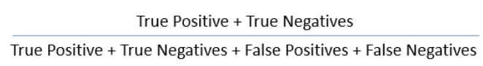
Terms Frequently Used
Accuracy : Accuracy is a metric by which one can examine how good is the machine learning model.
Backpropagation: In neural networks, if the estimated output is far away from the actual output (high error), we update the biases and weights based on the error. This weight and bias updating process is known as Back Propagation. Back-propagation (BP) algorithms work by determining the loss (or error) at the output and then propagating it back into the network. The weights are updated to minimize the error resulting from each neuron. The first step in minimizing the error is to determine the gradient (Derivatives) of each node w.r.t. the final output.

Slide 18
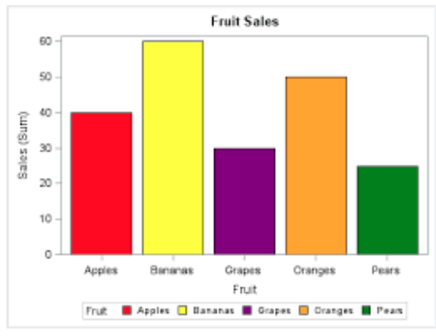
Terms Frequently Used
Bar Chart : Bar charts are a type of graph that are used to display and compare the numbers, frequency or other measures (e.g. mean) for different discrete categories of data. They are used for categorical variables. Simple example of a bar chart:

Slide 19
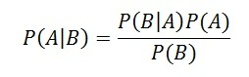
Terms Frequently Used
Bayes Theorem : Bayes’ theorem is used to calculate the conditional probability. Conditional probability is the probability of an event ‘B’ occurring given the related event ‘A’ has already occurred.
Boosting : Boosting is a sequential process, where each subsequent model attempts to correct the errors of the previous model. The succeeding models are dependent on the previous model. Some of the boosting algorithms are:
AdaBoost
GBM
XGBM
LightGBM
CatBoost

Slide 20
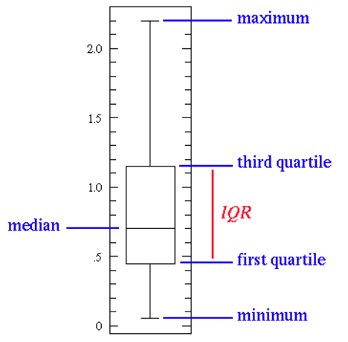
Terms Frequently Used
Box Plot : It displays the full range of variation (from min to max), the likely range of variation (the Interquartile range), and a typical value (the median). Below is a visualization of a box plot:
Some of the inferences that can be made from a box plot:
Median: Middle quartile marks the median.
Middle box represents the 50% of the data
First quartile: 25% of data falls below these line
Third quartile: 75% of data falls below these line.

Slide 21
Terms Frequently Used
Classification: The goal is to predict discrete values, e.g. {1,0}, {True, False}, {spam, not spam}. It is supervised learning method where the output variable is a category, such as “Male” or “Female” or “Yes” and “No”.
For example: Classification Algorithms like Logistic Regression, Decision Tree, K-NN, SVM etc.
Clustering : Clustering is an unsupervised learning method used to discover the inherent groupings in the data. For example: Grouping customers on the basis of their purchasing behaviour which is further used to segment the customers. And then the companies can use the appropriate marketing tactics to generate more profits.
Example of clustering algorithms: K-Means, hierarchical clustering, etc.

Slide 22
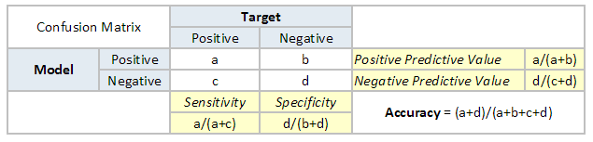
Terms Frequently Used
Confusion Matrix :A confusion matrix is a table that is often used to describe the performance of a classification model. It is a N * N matrix, where N is the number of classes. We form confusion matrix between prediction of model classes Vs actual classes. The 2nd quadrant is called type II error or False Negatives, whereas 3rd quadrant is called type I error or False positives.

Slide 23
Terms Frequently Used
Continuous Variable : Continuous variables are those variables which can have infinite number of values but only in a specific range. For example, height is a continuous variable.
Convergence :Convergence refers to moving towards union or uniformity. An iterative algorithm is said to converge when as the iterations proceed the output gets closer and closer to a specific value.
Cross Validation: Cross Validation is a technique which involves reserving a particular sample of a dataset which is not used to train the model. Later, the model is tested on this sample to evaluate the performance. There are various methods of performing cross validation such as:
Leave one out cross validation (LOOCV)
k-fold cross validation
Stratified k-fold cross validation
Adversarial validation

Slide 24
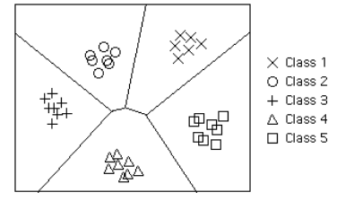
Terms Frequently Used
Decision Boundary : In a statistical-classification problem with two or more classes, a decision boundary or decision surface is a hypersurface that partitions the underlying vector space into two or more sets, one for each class. How well the classifier works depends upon how closely the input patterns to be classified resemble the decision boundary. In the example sketched below, the correspondence is very close, and one can anticipate excellent performance.
Here the lines separating each class are decision boundaries.

Slide 25
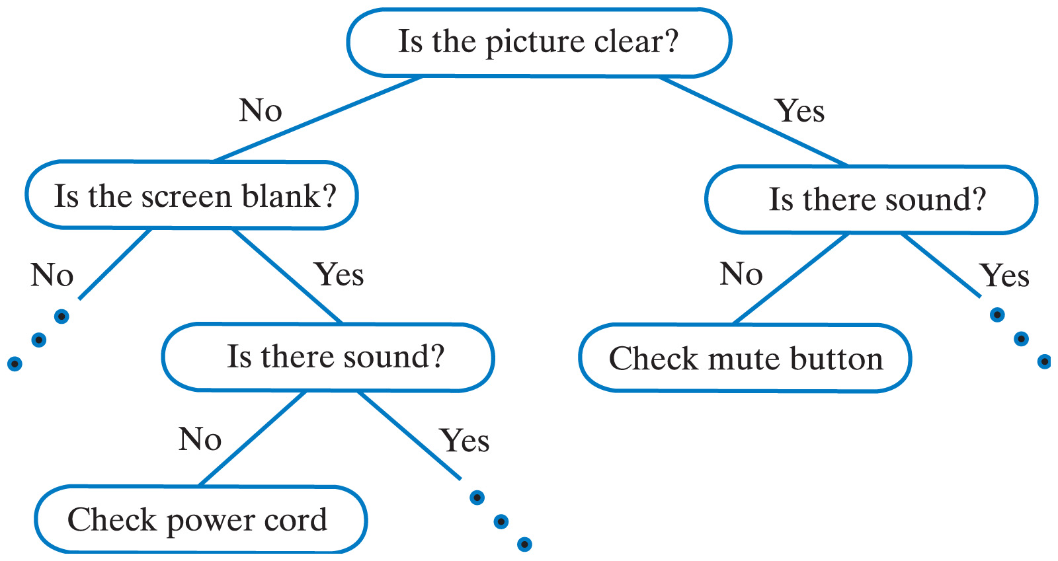
Terms Frequently Used
Decision Tree : Decision tree is a type of supervised learning algorithm (having a pre-defined target variable) that is mostly used in classification problems. It works for both categorical and continuous input & output variables. In this technique, we split the population (or sample) into two or more homogeneous sets (or sub-populations) based on most significant splitter / differentiator in input variables.

Slide 26
Terms Frequently Used
Deep Learning : Deep Learning is associated with a machine learning algorithm (Artificial Neural Network, ANN) which uses the concept of human brain to facilitate the modeling of arbitrary functions. ANN requires a vast amount of data and this algorithm is highly flexible when it comes to model multiple outputs simultaneously.
Dependent Variable : A dependent variable is what you measure and which is affected by independent / input variable(s). It is called dependent because it “depends” on the independent variable. For example, let’s say we want to predict the smoking habits of people. Then the person smokes “yes” or “no” is the dependent variable.
False Negative : Points which are actually true but are incorrectly predicted as false. For example, if the problem is to predict the loan status. (Y-loan approved, N-loan not approved). False negative in this case will be the samples for which loan was approved but the model predicted the status as not approved.
False Positive: Points which are actually false but are incorrectly predicted as true. For example, if the problem is to predict the loan status. (Y-loan approved, N-loan not approved). False positive in this case will be the samples for which loan was not approved but the model predicted the status as approved.

Slide 27
Terms Frequently Used
Gradient Descent: Gradient descent is a first-order iterative optimization algorithm for finding the minimum of a function. In machine learning algorithms, we use gradient descent to minimize the cost function. It find out the best set of parameters for our algorithm. Gradient Descent can be classified as follows:
On the basis of data ingestion:
Full Batch Gradient Descent Algorithm
Stochastic Gradient Descent Algorithm
In full batch gradient descent algorithms, we use whole data at once to compute the gradient, whereas in stochastic we take a sample while computing the gradient.
On the basis of differentiation techniques:
First order Differentiation
Second order Differentiation

Slide 28
Terms Frequently Used
Hypothesis : Simply put, a hypothesis is a possible view or assertion of an analyst about the problem he or she is working upon. It may be true or may not be true
Labeled Data: Data consisting of a set of training examples, where each example is a pair consisting of an input and a desired output value (also called the supervisory signal, labels, etc). A label is the thing we're predicting—the y variable in simple linear regression. The label could be the future price of wheat, the kind of animal shown in a picture, the meaning of an audio clip, or just about anything.
Maximum Likelihood Estimation : It is a method for finding the values of parameters which make the likelihood maximum. The resulting values are called maximum likelihood estimates (MLE).
Multivariate Analysis : Multivariate analysis is a process of comparing and analyzing the dependency of multiple variables over each other.

Slide 29
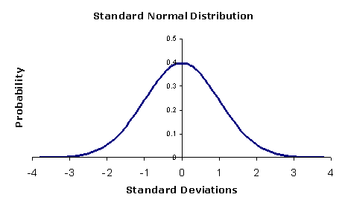
Terms Frequently Used
Naive Bayes : It is a classification technique based on Bayes’ theorem with an assumption of independence between predictors. In simple terms, a Naive Bayes classifier assumes that the presence of a particular feature in a class is unrelated to the presence of any other feature. For example, a fruit may be considered to be an apple if it is red, round and about 3 inches in diameter. Even if these features depend on each other or upon the existence of the other features, a naive Bayes classifier would consider all of these properties to independently contribute to the probability that this fruit is an apple.
Normal Distribution : The normal distribution is the most important and most widely used distribution in statistics. It is sometimes called the bell curve, because it has a peculiar shape of a bell. Mostly, a binomial distribution is similar to normal distribution. The difference between the two is normal distribution is continuous.

Slide 30
Terms Frequently Used
Normalization : Normalization is the process of rescaling your data so that they have the same scale. Normalization is used when the attributes in our data have varying scales.
For example, if you have a variable ranging from 0 to 1 and other from 0 to 1000, you can normalize the variable, such that both are in the range 0 to 1.
Overfitting : A model is said to overfit when it performs well on the train dataset but fails on the test set. This happens when the model is too sensitive and captures random patterns which are present only in the training dataset. There are two methods to overcome overfitting:
Reduce the model complexity
Regularization

Slide 31
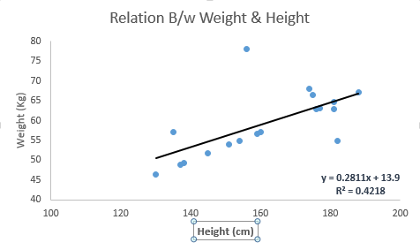
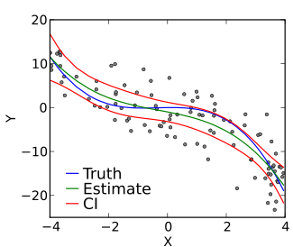
Terms Frequently Used
Regression: It is supervised learning method where the output variable is a real value, such as “amount” or “weight”.
Example of Regression: Linear Regression, Ridge Regression, Lasso Regression
Linear Regression : is a method for finding the straight line or hyperplane that best fits a set of points. Y=aX+b , where:
Y – Dependent Variable
a – Slope
X – Independent variable
b – Intercept
Polynomial Regression :In this technique, a curve fits into the data points. In a polynomial regression equation, the power of the independent variable is greater than 1. Although higher degree polynomials give lower error, they might also result in over-fitting.

Slide 32
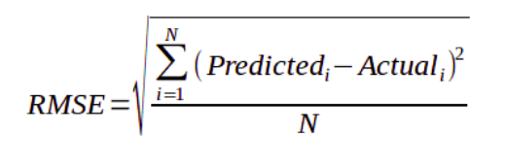
Terms Frequently Used
Root Mean Squared Error (RMSE):RMSE is a measure of the differences between values predicted by a model or an estimator and the values actually observed. It is the standard deviation of the residuals. Residuals are a measure of how far from the regression line data points are. The formula for RMSE is given by:
Here,
Predicted -> value predicted by the model
Actual -> observed values
N -> Total number of observations

Slide 33
Terms Frequently Used
Underfitting: Underfitting occurs when a statistical model or machine learning algorithm cannot capture the underlying trend of the data. It refers to a model that can neither model on the training data nor generalize to new data. An underfit model is not a suitable model as it will have poor performance on the training data.
Univariate Analysis : Univariate analysis is comparing and analyzing the dependency of a single predictor and a response variable
True Negative : These are the points which are actually false and we have predicted them false.
True Positive : These are the points which are actually true and we have predicted them true.

Slide 34
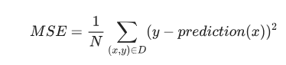
Terms Frequently Used
Model: A model defines the relationship between features and label. For example, a spam detection model might associate certain features strongly with "spam".
Training means creating or learning the model. That is, you show the model labeled examples and enable the model to gradually learn the relationships between features and label
Loss : Loss for a given example is also called squared error .
= Square of the difference between prediction and label
= (observation - prediction)²
= (y - y’)²
Mean square error (MSE) is the average squared loss per example over the whole dataset. To calculate MSE, sum up all the squared losses for individual examples and then divide by the number of examples:

Slide 35
5. Types of Machine Learning Algorithms
Based on Depth of Learning
Based on Type of learning

Slide 36
5.1 Based on Depth of Learning
Shallow Learning
Algorithms with Few Layers
Better for Less Complex and Smaller Data sets
Eg: Logistic Regression and Support vector Machines
Deep Learning
New technique that uses many layers of neural network ( a model based on the structure of human brain)
Useful when the target function is very complex and data sets are very large.

Slide 37
5.2 Based on Type of Learning
Supervised Learning
X and Y
Given an observation X what is the best label for Y
Unsupervised Learning
X
Given a set of X cluster or summarize them
Semi Supervised Learning
Reinforcement Learning
Determine what to do based on Rewards and punishments

Slide 38
5.2.1. Supervised Learning
Here the training (labeled) data set containing input/predictors and output will be fed to the machine. The machine with the help of algorithm analyze the data set and generates a suitable model /function that best describes the input data. i.e it generates a function f(X) which makes best estimation of the output X for given X.
The generated model / function can be used to predict the output values for new data based on those relationships which it learned from the previous data sets.
When Y is discrete (True /False, ..) – Classification
When X is continuous (Real Numbers )- Regression

Slide 39
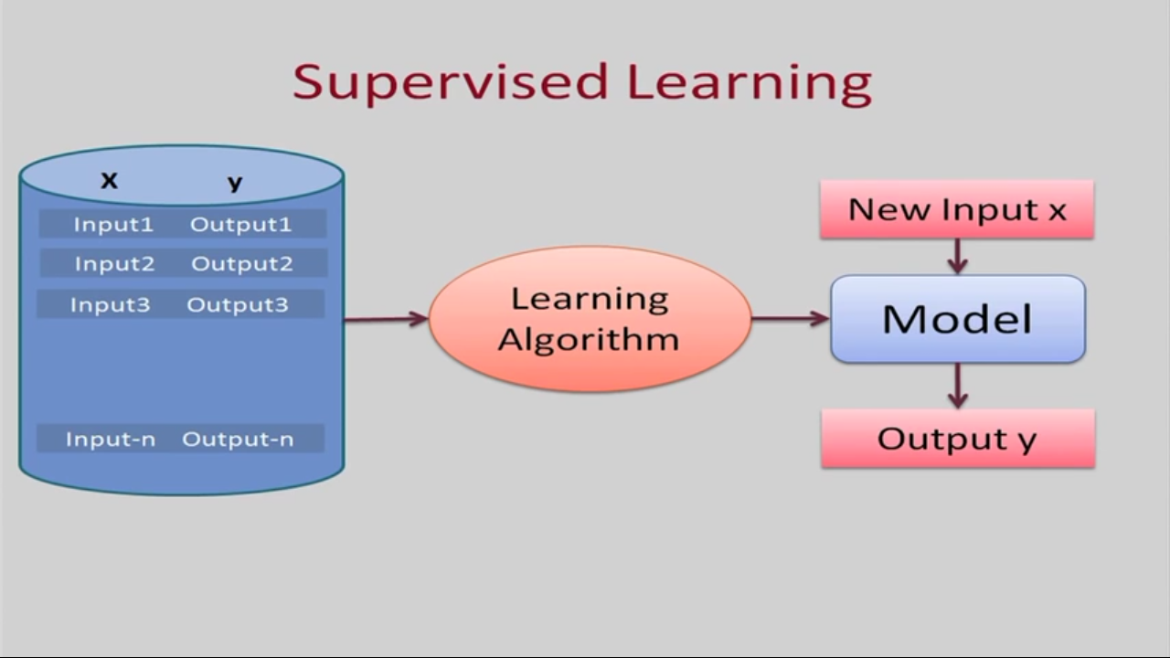

Slide 40
Types of Supervised Learning (Task Driven . Develop Prediction Model based on Input and Output Data)
Classification ( Discrete)
Logistic Regression
KNN
Decision Trees
Support Vector Machines
Naïve Bayesian
Discriminant Analysis
Random Forest
AdaBoost
Neural Networks
Regression ( Continuous)
Linear Regression
SVR
GPR
Ensemble Methods

Slide 41
5.2.2: Unsupervised Learning
This approach is data driven . The computer is trained with unlabeled input data.
These algorithms try to use techniques on the input data to mine for rules, detect patterns, and summarize and group the data points which help in deriving meaningful insights and describe the data better to the users.

Slide 42
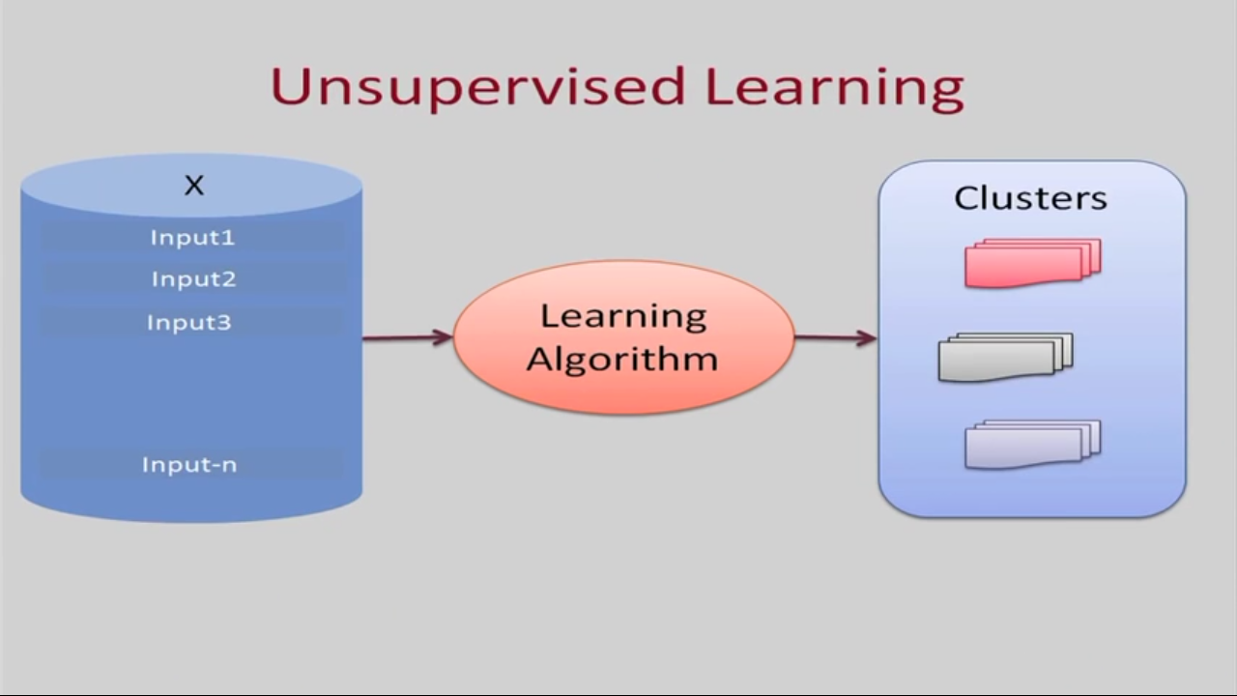

Slide 43
Types of Unsupervised Learning
Clustering
K Means Clustering
Hierarchical Clustering
Gaussian Mixture Models
Genetic Algorithms
Artificial Neural Networks
Dimensionality Reduction
Tensor Decomposition
Principal Component Analysis
Multidimensional statistics
Random Projection
Artificial Neural Networks
Association Rules

Slide 44
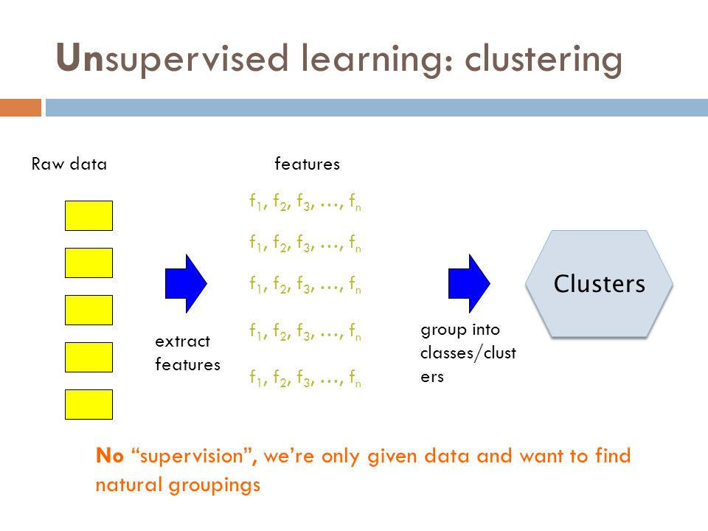

Slide 45
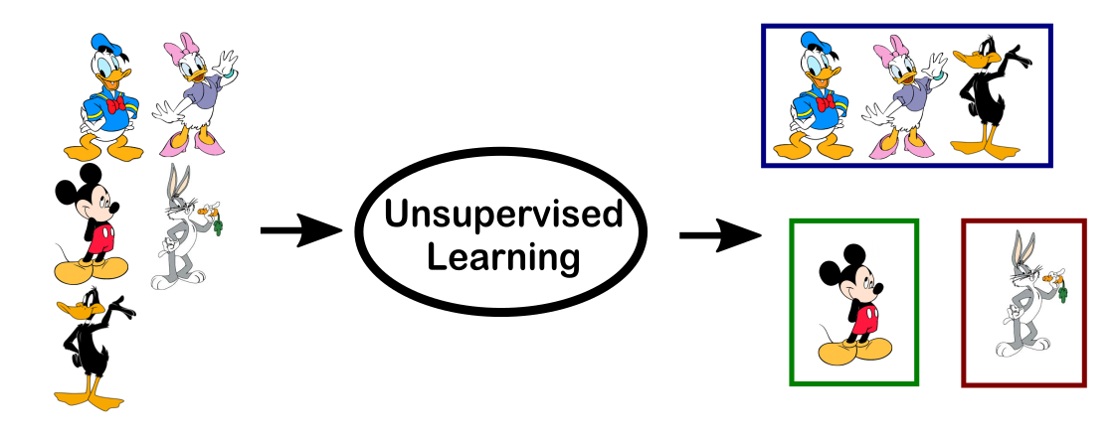

Slide 46
5.2.3. Semi Supervised
In the previous two types, either there are no labels for all the observation in the dataset or labels are present for all the observations.
Semi-supervised learning falls in between these two.

Slide 47
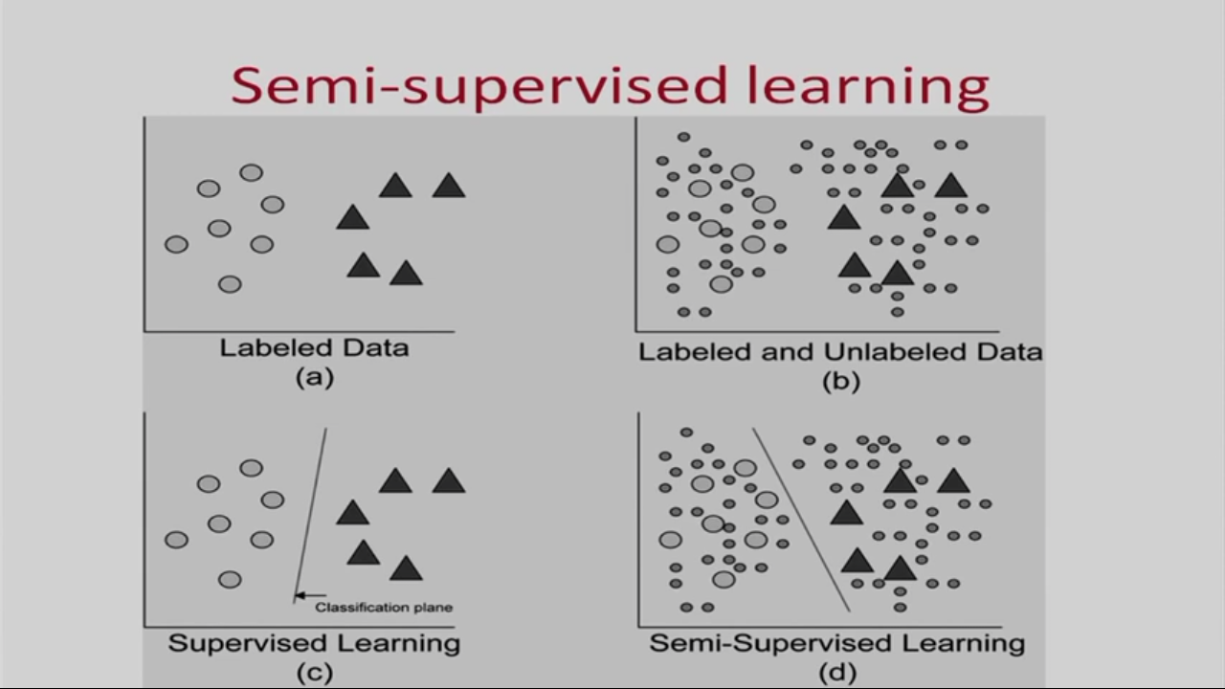

Slide 48
5.2.4. Reinforcement Learning
This method aims at using observations gathered from the interaction with the environment to take actions that would maximize the reward or minimize the risk.
Reinforcement learning algorithm (called the agent) continuously learns from the environment in an iterative fashion.

Slide 49
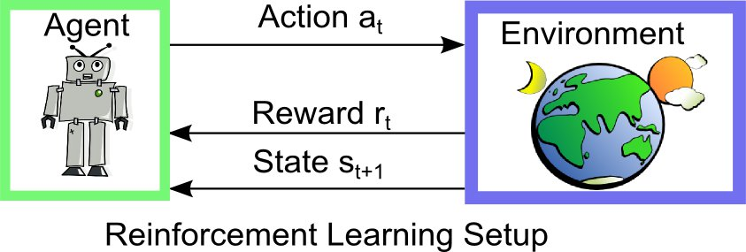

Slide 50
Types of Reinforcement Learning Algorithms
Q-Learning
Temporal Difference (TD)
Deep Adversarial Networks

Slide 51
Table1: Examples of Types of Machine Learning Algorithms / Problem Solving Approaches
Type | Model /Algorithm or Task | Usage Examples in Business
Supervised | Neural network | ■ Predicting financial results ■ Fraud detection
Supervised | Classification and/or Regression | ■ Spam filtering ■ Fraud detection
Supervised | Decision tree | ■ Risk assessment ■ Threat management systems ■ Any optimization problem where an exhaustive search is not feasible

Slide 52
Table1: Examples of Types of Machine Learning Algorithms / Problem Solving Approaches
Type | Model /Algorithm or Task | Usage Examples in Business
Unsupervised | Cluster analysis | ■ Financial transactions ■ Streaming analytics in IoT ■ Underwriting in insurance
Unsupervised | Pattern recognition | ■ Spam detection ■ Biometrics ■ Identity management
Unsupervised | Association rule learning | ■ Security and intrusion detection ■ Bioinformatics ■Manufacturing and Assembly

Slide 53
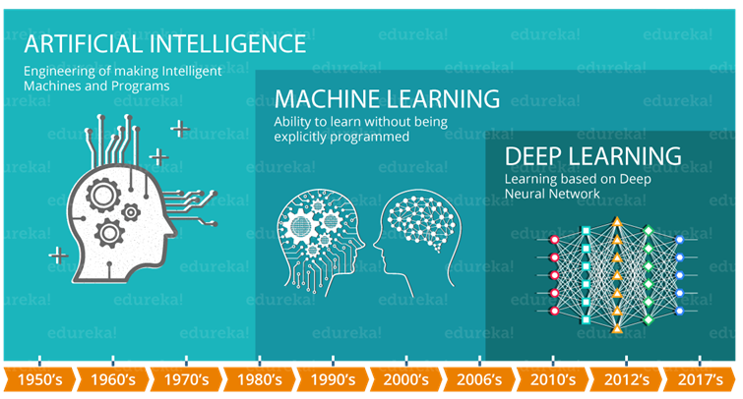

Slide 54
6. Open Source and Commercial Tools

Slide 55
Open Source Tools
OpenAI
TensorFlow
Keras
Charnn
PaddlePAddle
CNTK
R
Monte Carlo ML Library
Octave Forge
Scikit Learn
Shogun
Accord.NET Framework
Spark MLlib
H20
Coudera Oryx
GoLearn
Weka
Deep Learn.js
ConvNet.Js

Slide 56
Commercial Tools
Microsoft Azure Machine Learning
SAS Enterprise Miner
IBM SPSS Modeler
RapidMiner
Apache Mahout
MATLAB
Oracle Data Mining

Slide 57
7. Introduction to Scikit Learn – A Python Machine Learning Library

Slide 58
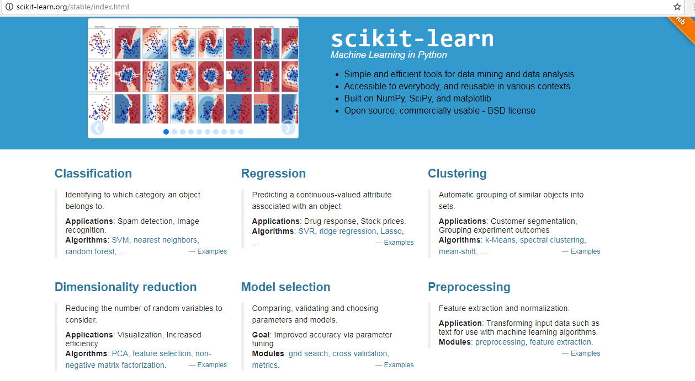
Scikit Learn : http://scikit-learn.org/stable/index.html

Slide 59
Where did it Come From ?
Scikit-learn was initially developed by David Cournapeau as a Google summer of code project in 2007.
Later Matthieu Brucher joined the project and started to use it as apart of his thesis work. In 2010 INRIA got involved and the first public release (v0.1 beta) was published in late January 2010.
The project now has more than 30 active contributors and has had paid sponsorship from INRIA, Google, Tinyclues and the Python Software Foundation.

Slide 60
What is scikit-learn?
Scikit-learn provides a range of supervised and unsupervised learning algorithms via a consistent interface in Python.
It is licensed under a permissive simplified BSD license and is distributed under many Linux distributions, encouraging academic and commercial use.
The library is built upon the SciPy (Scientific Python) that must be installed before you can use scikit-learn.

Slide 61
Scikit Stack
NumPy: Base n-dimensional array package
SciPy: Fundamental library for scientific computing
Matplotlib: Comprehensive 2D/3D plotting
IPython: Enhanced interactive console
Sympy: Symbolic mathematics
Pandas: Data structures and analysis

Slide 62
Some popular groups of models provided by scikit-learn include:
Clustering: for grouping unlabeled data such as KMeans.
Cross Validation: for estimating the performance of supervised models on unseen data.
Datasets: for test datasets and for generating datasets with specific properties for investigating model behavior.
Dimensionality Reduction: for reducing the number of attributes in data for summarization, visualization and feature selection such as Principal component analysis.
Ensemble methods: for combining the predictions of multiple supervised models.
Feature extraction: for defining attributes in image and text data.
Feature selection: for identifying meaningful attributes from which to create supervised models.
Parameter Tuning: for getting the most out of supervised models.
Manifold Learning: For summarizing and depicting complex multi-dimensional data.
Supervised Models: a vast array not limited to generalized linear models, discriminate analysis, naive bayes, lazy methods, neural networks, support vector machines and decision trees.

Slide 63
Example : Scikit learn Machine Learning
There are 5 key libraries that you will need to install. Below is a list of the Python SciPy libraries required for this tutorial:
scipy
numpy
matplotlib
pandas
sklearn

Slide 64
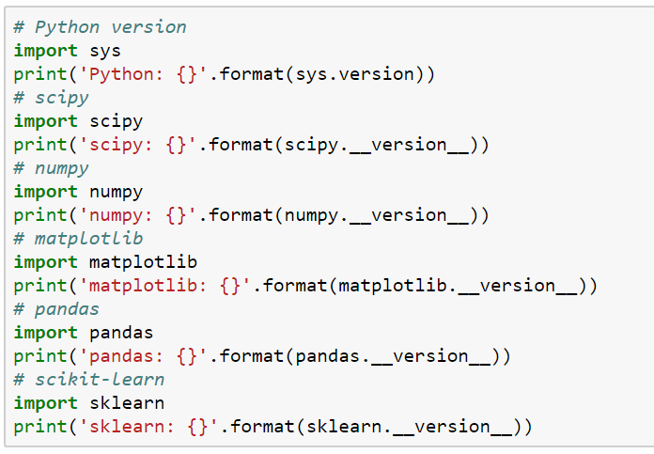
7.1. Check the versions of libraries

Slide 65
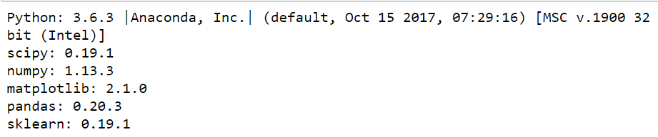

Slide 66
7.2. Load The Data
We are going to use the iris flowers dataset. This dataset is famous because it is used as the “hello world” dataset in machine learning and statistics by pretty much everyone.
The dataset contains 150 observations of iris flowers. There are four columns of measurements of the flowers in centimeters. The fifth column is the species of the flower observed. All observed flowers belong to one of three species.

Slide 67
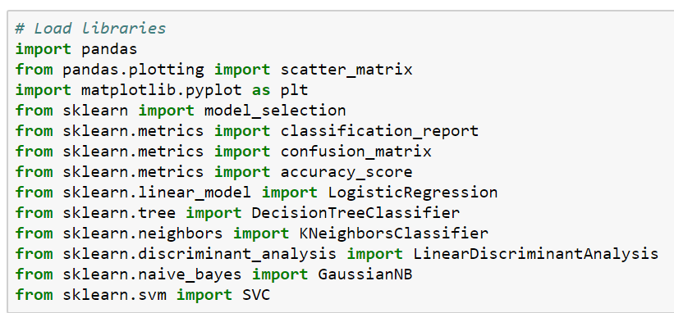
7.2.1 Load Libraries

Slide 68
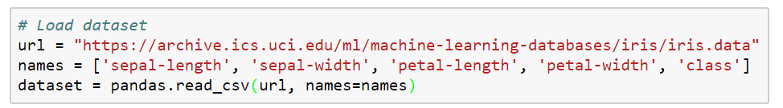
7.2.2 Load Dataset

Slide 69
7.3. Summarize the Dataset
In this step we are going to take a look at the data a few different ways:
Dimensions of the dataset.
Peek at the data itself.
Statistical summary of all attributes.
Breakdown of the data by the class variable

Slide 70
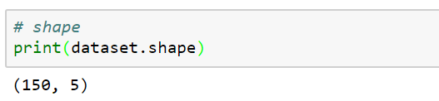
7.3.1 Dimensions of Dataset

Slide 71
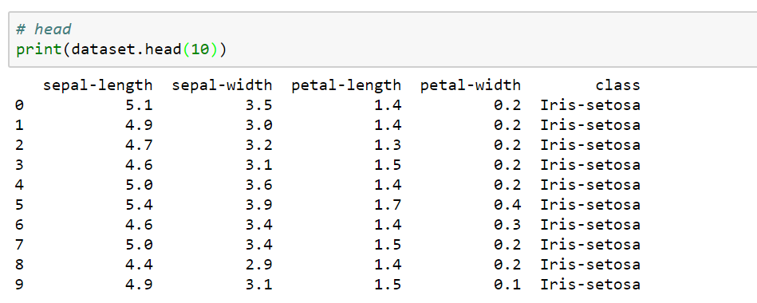
7.3.2 Peek at the Data

Slide 72
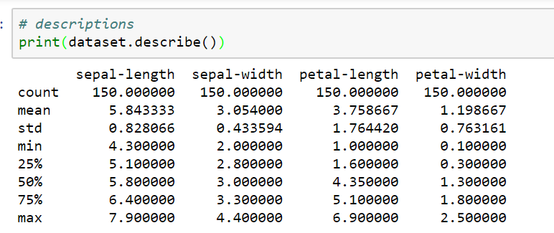
7.3.3 Statistical Summary

Slide 73
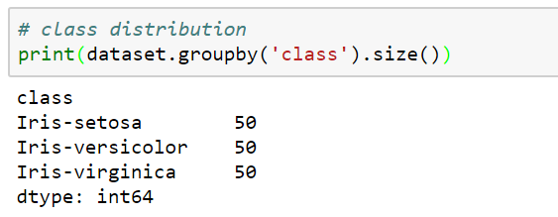
7.3.4 Class Distribution

Slide 74
7.4. Data Visualization
We now have a basic idea about the data. We need to extend that with some visualizations.
We are going to look at two types of plots:
Univariate plots to better understand each attribute.
Multivariate plots to better understand the relationships between attributes.

Slide 75
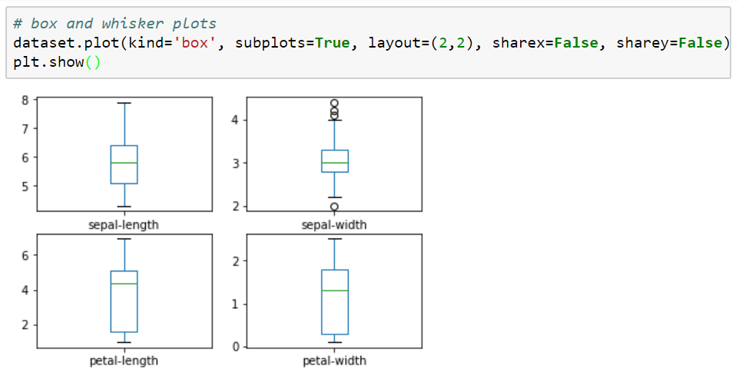
7.4.1 Univariate Plots

Slide 76
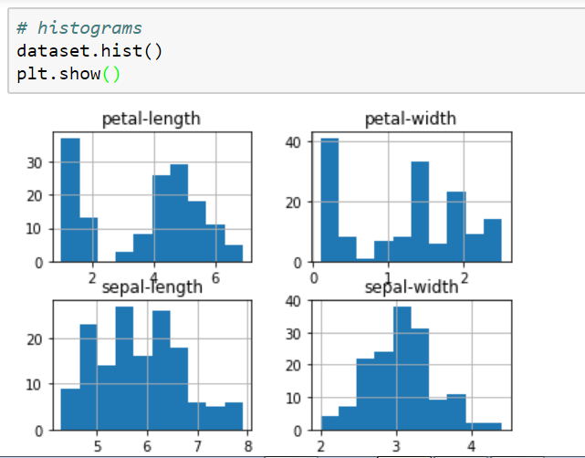
Histograms

Slide 77
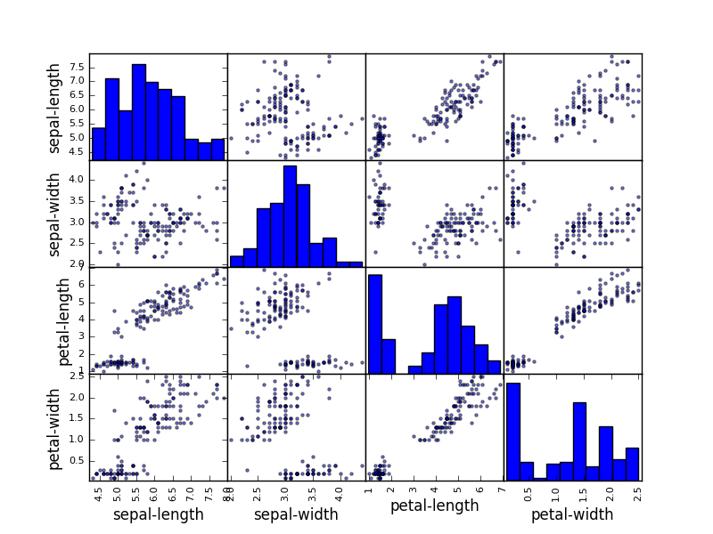
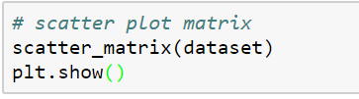
7.4.2 Multivariate Plots

Slide 78
7.5. Evaluate Some Algorithms
Here is what we are going to cover in this step:
Separate out a validation dataset.
Set-up the test harness to use 10-fold cross validation.
Build 5 different models to predict species from flower measurements
Select the best model.

Slide 79
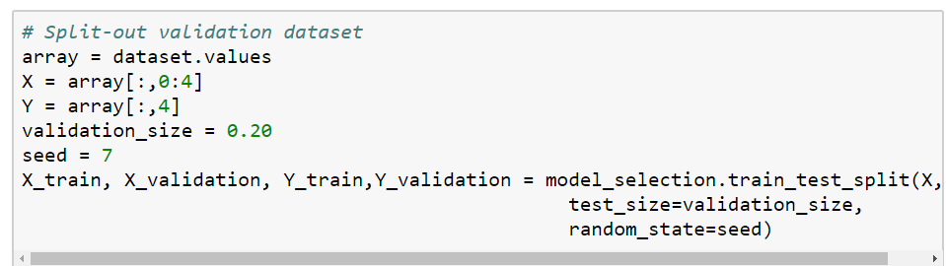
7.5.1 Create a Validation Dataset
We will split the loaded dataset into two, 80% of which we will use to train our models and 20% that we will hold back as a validation dataset

Slide 80
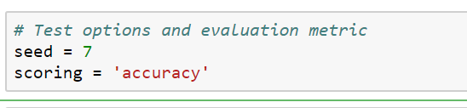
7.5.2 Test Harness
We will use 10-fold cross validation to estimate accuracy.
This will split our dataset into 10 parts, train on 9 and test on 1 and repeat for all combinations of train-test splits.

Slide 81
7.5.3 Build Models
Let’s evaluate 6 different algorithms:
Logistic Regression (LR)
Linear Discriminant Analysis (LDA)
K-Nearest Neighbors (KNN).
Classification and Regression Trees (CART).
Gaussian Naive Bayes (NB).
Support Vector Machines (SVM).

Slide 82
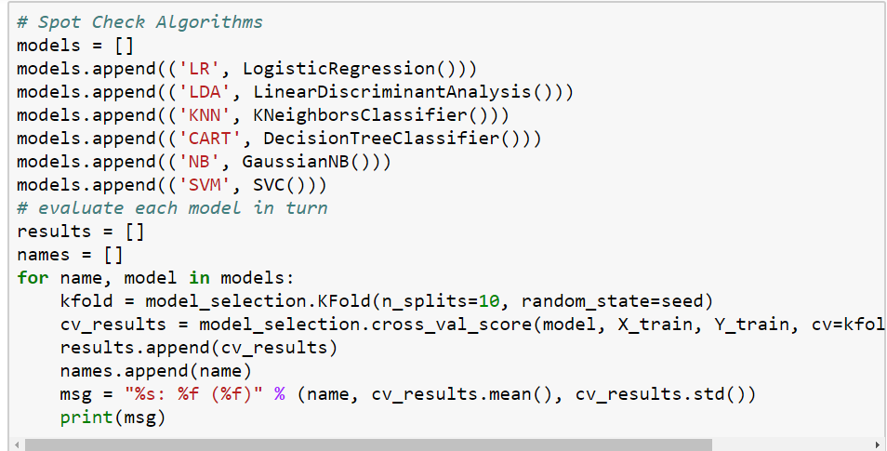

Slide 83
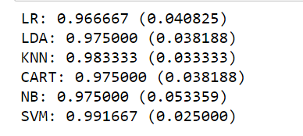
7.5.4 Select Best Model

Slide 84
8. Introduction to Deep Learning
Deep learning is a type of machine learning that is based on algorithms with extensive connections or layers between inputs and outputs.
ML neural nets have inputs (variables), hidden layers (functions that compute the output) and output (results).
In a simple example, imagine an ML neural net to detect a dog. This seemingly simple example may include a tail detector, ear detector, hair detector and so on.
These detectors are combined into layers that contribute to detecting a dog. The more "detectors" you have, the deeper the neural net.

Slide 85
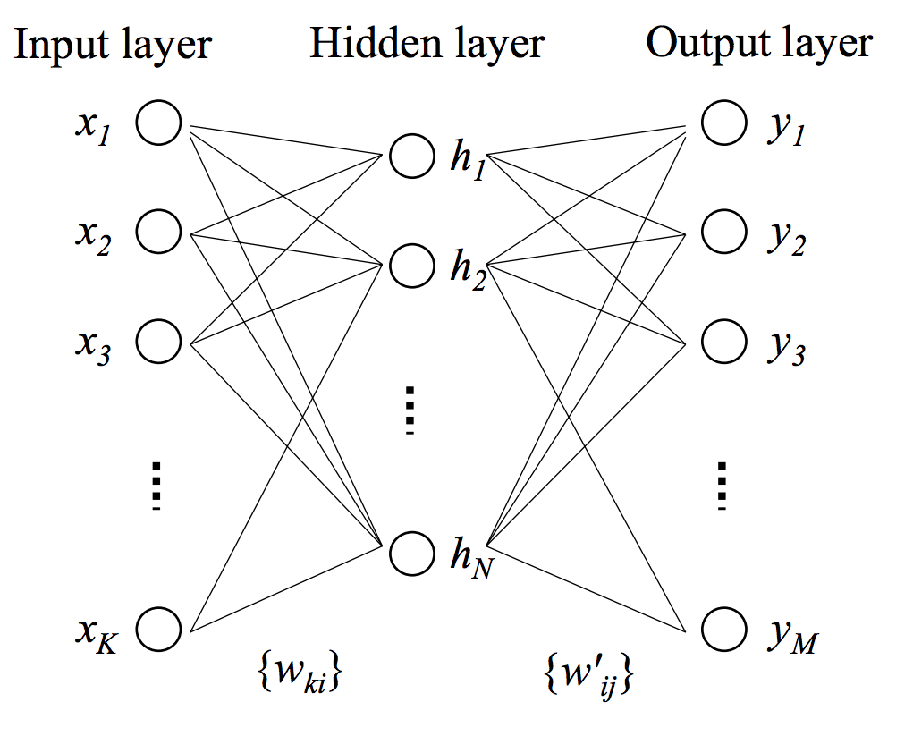
Deep Learning

Slide 86
Deep Learning Tools
Neural Designer
Torch
Apache SINGA
Microsoft Cognitive ToolKit
Keras
Deeplearning4j
Theano
MXNet
H2O.ai
ConvNetjs
DeepLEarningkit
Gensim
Caffe
ND4J
DeepLearnToolBox

Slide 87
2.Python Fundamentals

Slide 88
Python Introduction
Python is a general-purpose interpreted, interactive, object-oriented, and high-level programming language.
It was created by Guido van Rossum during 1985- 1990.
Python is named after a TV Show called ‘Monty Python’s Flying Circus’ and not after Python-the snake.

Slide 89
Features of Python
High-level Language and Simple
Free and Open Source
Portable
Interactive and Interpreted
Object Oriented
Scalable
Embeddable
Extensive Libraries
Database Support
Programming GUI/APP

Slide 90
Programming Editors
Python 3.6 Command Prompt
Python 3.6 Idle
Anaconda Prompt
Anaconda Jupyter Notebook
Anaconda Spider
JetBrains PyCharm

Slide 91
Python 3.6

Slide 92

Python3.6 Installation
Go to web page : https://www.python.org/downloads/

Slide 93


Slide 94
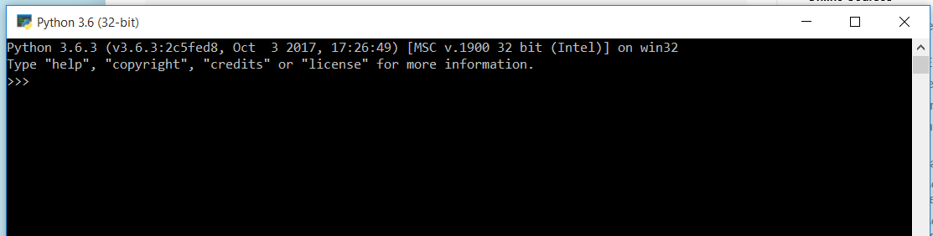
Interactive Python Programming

Slide 95
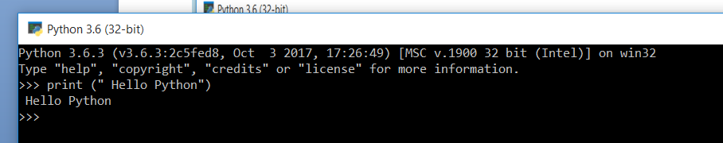

Slide 96
What is Anaconda?
The open source Anaconda Distribution is the easiest way to do Python data science and machine learning.
It includes hundreds of popular data science packages and the conda package and virtual environment manager for Windows, Linux, and MacOS.

Slide 97
Use Python for…
Web Development: Django, Pyramid, Bottle, Tornado, Flask, web2py
GUI Development: tkInter, PyGObject, PyQt, PySide, Kivy, wxPython
Scientific and Numeric: SciPy, Pandas, IPython
Software Development: Buildbot, Trac, Roundup
System Administration: Ansible, Salt, OpenStack

Slide 98
Some Python Packages/Libraries
Numpy
Scipy
Pandas
Matplotlib
Seaborn
Bokeh
Scikit Learn
Pygames
dJango
Flask
Bottle
Pyramid
PyBrain
PyMongo
Tornado
Web2py
Json
tKinter
OpenCV
PyGObject
PyQt
wxPython
Kivy
Buildozer
Buildbot
Trac
Roundup
Ansible
Salt
OpenStack
Keras
Tensor Flow
Theano
nltk
Spacy
TextBlog
ScikitLearn
Pattern
SQLalchemy
pyMySql

Slide 99

Downloading Anaconda
The latest version of Anaconda is available for download from https://www.anaconda.com/download/

Slide 100


Slide 101
JUPYTER NOTEBOOK

Slide 102
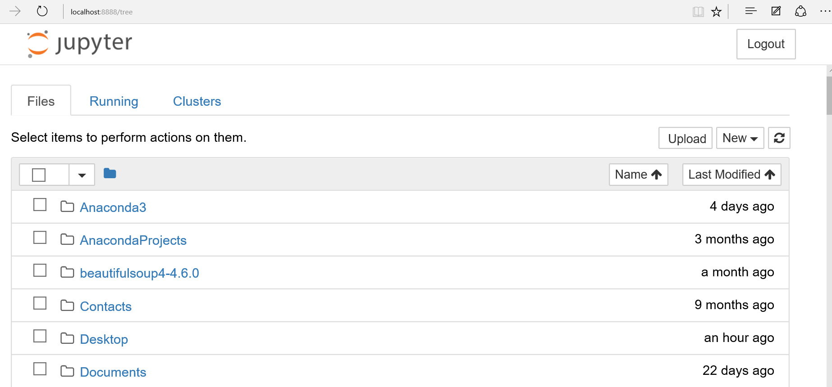

Slide 103
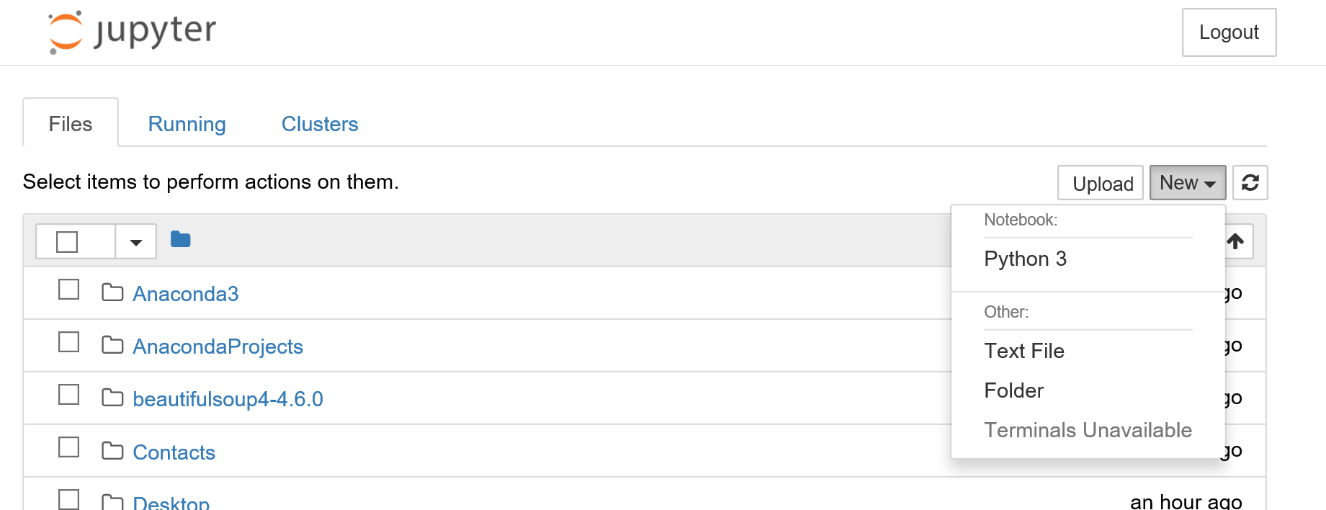

Slide 104
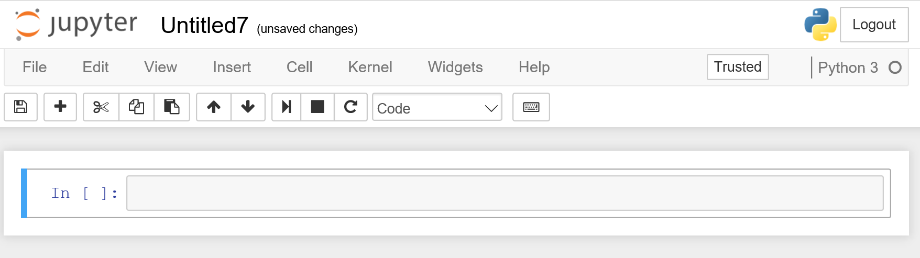

Slide 105
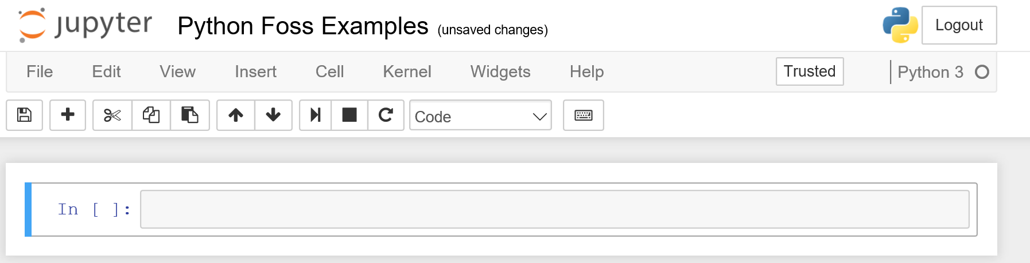

Slide 106
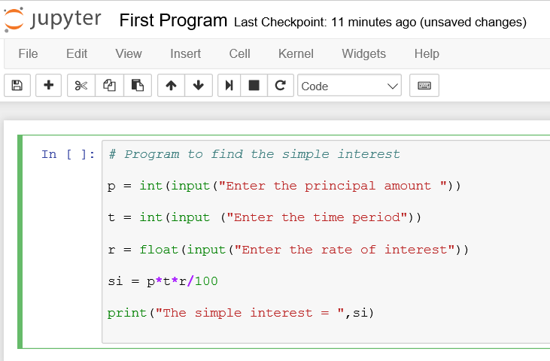

Slide 107
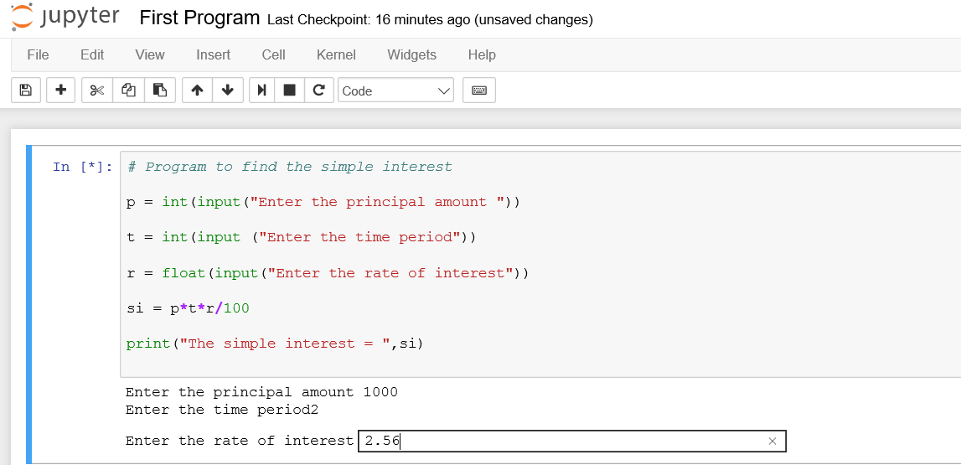

Slide 108
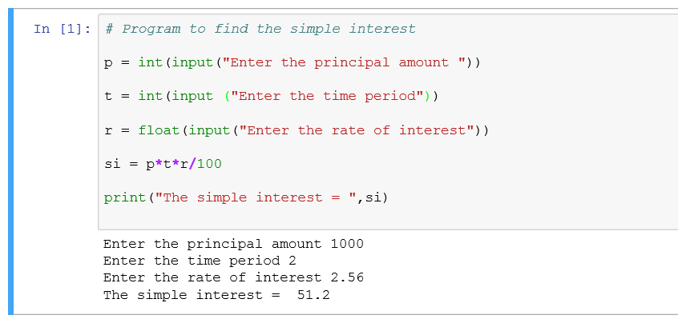

Slide 109
Data Types in Python
Floating Point Numbers | 1.2 | Immutable
Integer Numbers | 2 | Immutable
Complex Numbers | 1+2j | Immutable
Strings | “context” | Immutable
Lists | a = [1, 2.2, 'python'] | Mutable
Tuples | t = (5,'program', 1+3j) | Immutable
Dictionaries | d = {1:'value','key':2} | Immutable+ Mutable

Slide 110
Fundamentals of Python for ML
Hands On

Slide 111
3.Decision Tree Learning

Slide 112
Topics
Decision Tree Learning
Decision Trees
Decision Tree Representation
Appropriate Problems for Decision Tree Learning
Basic Decision Tree Learning Algorithm (ID3)
Advantages and Disadvantages of ID3 based Decision Tree Learning

Slide 113
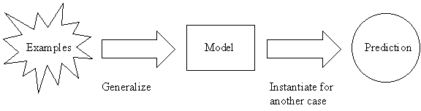
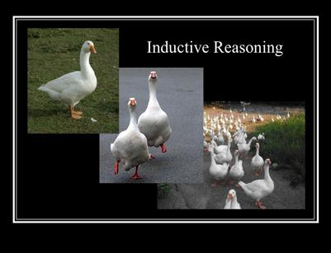
1. Decision Tree Learning
Decision tree learning is one of the most widely used and practical methods for inductive inference. It is a method for approximating discrete-valued target functions, in which the learned function is represented by a decision tree.
Inductive inference is the process of reaching a general conclusion from specific examples.
Is a type of supervised machine learning that is mostly used in classification .

Slide 114
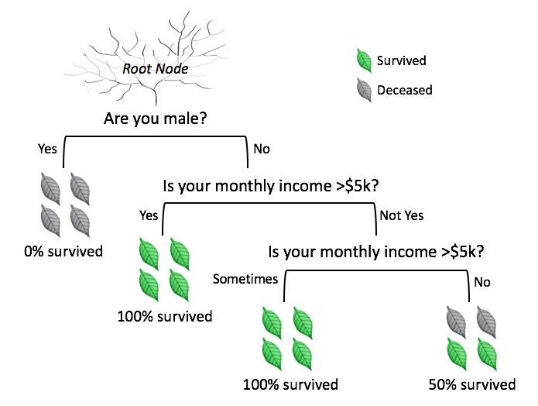
2. Decision Trees
A decision tree is a graphical representation of all possible solutions to decisions based on certain conditions.
A tree structured classifier with two types of nodes :
Decision Nodes and
Leaf Nodes.

Slide 115
3. Decision Tree Representation
Decision trees classify instances by sorting them down the tree from the root to some leaf node, which provides the classiﬁcation of the instance.
In the decision tree representation:
An inner node represents an attribute
Edge / branch represents an attribute value
Leaf represents a class
The paths from root to leaf represent classification rules.
Decision trees represent a disjunction of conjunctions.
Each path from root to a leaf is a conjunction of attribute tests.
The tree itself is a disjunction of these conjunctions.

Slide 116
Training Examples (Data Set)
Day | Outlook | Temp. | Humidity | Wind | Play Tennis
D1 | Sunny | Hot | High | Weak | No
D2 | Sunny | Hot | High | Strong | No
D3 | Overcast | Hot | High | Weak | Yes
D4 | Rain | Mild | High | Weak | Yes
D5 | Rain | Cool | Normal | Weak | Yes
D6 | Rain | Cool | Normal | Strong | No
D7 | Overcast | Cool | Normal | Weak | Yes
D8 | Sunny | Mild | High | Weak | No
D9 | Sunny | Cold | Normal | Weak | Yes
D10 | Rain | Mild | Normal | Strong | Yes
D11 | Sunny | Mild | Normal | Strong | Yes
D12 | Overcast | Mild | High | Strong | Yes
D13 | Overcast | Hot | Normal | Weak | Yes
D14 | Rain | Mild | High | Strong | No

Slide 117
Decision Tree for PlayTennis
Outlook
Sunny
Overcast
Rain
Humidity
Yes
Wind
High
Normal
Strong
Weak
No
Yes
No
Yes

Slide 118
Decision Tree for PlayTennis
Outlook
Outlook
Sunny
Overcast
Rain
Humidity
Each internal node tests an attribute
High
Normal
Each branch corresponds to an
attribute value node
No
Yes
Each leaf node assigns a classification

Slide 119
Decision Tree for Conjunction
Outlook=Sunny ∧ Wind=Weak
Outlook
Sunny
Overcast
Rain
Wind
No
No
Strong
Weak
No
Yes

Slide 120
Decision Tree for Disjunction
Outlook=Sunny ∨ Wind=Weak
Outlook
Sunny
Overcast
Rain
Yes
Wind
Wind
Strong
Weak
Strong
Weak
No
Yes
No
Yes

Slide 121
Decision Tree for XOR
Outlook = Sunny XOR Wind = Weak
Outlook
Sunny
Overcast
Rain
Wind
Wind
Wind
Strong
Weak
Strong
Weak
Strong
Weak
Yes
No
No
Yes
No
Yes

Slide 122
Decision Tree Expressivity
Decision trees represent a disjunction of conjunctions on constraints on the value of attributes:
Outlook
Sunny
Overcast
Rain
Humidity
Yes
Wind
High
Normal
Strong
Weak
No
Yes
No
Yes
(Outlook=Sunny ∧ Humidity=Normal)
∨ (Outlook=Overcast)
∨ (Outlook=Rain ∧ Wind=Weak)

Slide 123
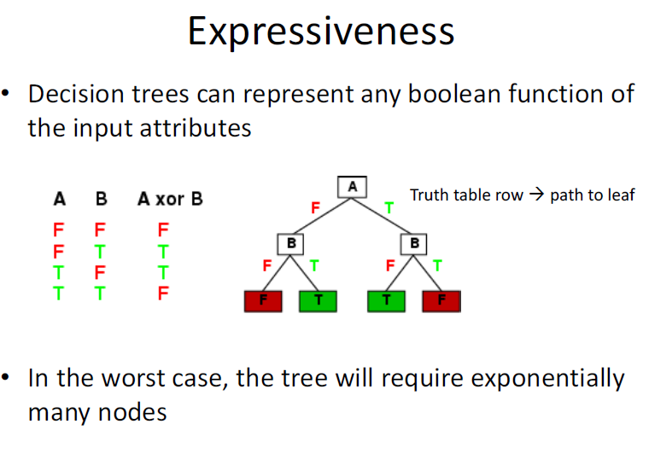

Slide 124
4. Appropriate Problems for Decision Tree Learning
Decision tree learning is generally best suited to problems with the following characteristics:
Instances describable by attribute-value pairs. (Hot, Mild, Cold)
Target function has discrete output values (yes or no).
Disjunctive hypothesis/description may be required.
The training data may contain errors/noisy data.
The training data may contain missing attribute values.
Some examples of problems that ﬁt to these characteristics are:
Medical or equipment diagnosis
Credit risk analysis
Modelling calendar scheduling preferences

Slide 125
5.Basic Decision Tree Learning Algorithm (ID3)
The basic decision tree learning algorithm, ID3, employs a top-down, greedy search through the space of possible decision trees, beginning with the question ”which attribute should be tested at the root of the tree?”.

Slide 126
Day | Outlook | Temperature | Humidity | Wind | PlayTennis
D1 | Sunny | Hot | High | Weak | No
D2 | Sunny | Hot | High | Strong | No
D3 | Overcast | Hot | High | Weak | Yes
D4 | Rain | Mild | High | Weak | Yes
D5 | Rain | Cool | Normal | Weak | Yes
D6 | Rain | Cool | Normal | Strong | No
D7 | Overcast | Cool | Normal | Strong | Yes
D8 | Sunny | Mild | High | Weak | No
D9 | Sunny | Cool | Normal | Weak | Yes
D10 | Rain | Mild | Normal | Weak | Yes
D11 | Sunny | Mild | Normal | Strong | Yes
D12 | Overcast | Mild | High | Strong | Yes
D13 | Overcast | Hot | Normal | Weak | Yes
D14 | Rain | Mild | High | Strong | No

Slide 127
Description of PlayTennis Training Data Examples
No of Data Examples : 14
No of Yes (+) : 9
No of No (-) : 5
Data Example Attributes and their possible Values :
[Outlook ] Values : { Sunny ,Overcast ,Rain }
[Temperature] Values : { Hot , Mild , Cold }
[Humidity] Values : { High, Normal }
[Wind] Values : { Weak, Strong }
Target Attribute :
[PlayTennis] Values : {Yes, No}

Slide 128


Slide 129
Which attribute is the Best Classifier ?
The central choice in the ID3 algorithm is selecting which attribute to test at each node in the tree.
The attribute must be selected that is most useful for classifying examples .
The statistical property called information gain is the good quantitative measure of the worth of an attribute .
Information Gain measures how well a given attribute separates the training examples according to their target classification.
ID3 uses this information gain measure to select among the candidate attributes at each step while growing the tree.
Information gain uses the notion of entropy, commonly used in information theory
Information gain = expected reduction of entropy

Slide 130


Slide 131


Slide 132


What is Entropy ?
Define and measures Randomness/impurity in the Data
Minimum number of bits of information needed to encode the classification of an arbitrary member of Examples Space S.
If the target attribute can take on c possible values the entropy can be as large as $\log_{2} c$

Slide 133


Slide 134



1. Entropy measures Homogeneity of Examples

Slide 135

Examples
E(S) = - $p_{+}\log_{2}p_{+}$ - $p_{−}\log_{2}{ p}_{−}$
E(9+,5-) = -(9/14)$\log_{2}$(9/14) - (5/14) $\log_{2}$(5/14)
= 0.940

Slide 136
Entropy (S) ≡ – p₊ log₂ p₊ – p–log₂ p–
Entropy ([14+, 0–]) = – 14/14 log₂ (14/14) – 0 log₂ (0) = 0
Entropy ([9+, 5–]) = – 9/14 log₂ (9/14) – 5/14 log₂ (5/14) = 0.94
Entropy ([7+, 7– ]) = – 7/14 log₂ (7/14) – 7/14 log₂ (7/14)
= 1/2 + 1/2 = 1 [log₂1/2 = – 1]
Notes:
S=[9+, 5-] una collezione di esempi di cui 9 positivi e 5 negativi

Slide 137

2. Information Gain Measures the expected reduction in Entropy
Information Gain is the expected reduction in entropy caused by partitioning the examples on an attribute. The higher the information gain the more effective the attribute in classifying training data.

Slide 138

An Illustrative Example
To illustrate the operation of ID3, let’s consider the learning task represented by the below examples.

Slide 139


Compute the Gain and identify which attribute is the best as illustrated below
Values (Wind) = Weak, Strong
S = [9+,5-]
$S_{weak}=\left[6+, 2−\right]$
$S_{strong}=\left[3+,3−\right]$
= Entropy (S) – (8/14)Entropy($S_{weak}$) – (6/14)Entropy($S_{strong}$)
= 0.940 – (8/14)0.811 – (6/14)1.00
= 0.048

Slide 140


Slide 141
Which attribute to test at the root?
Gain(S, Outlook) = 0.246
Gain(S, Humidity) = 0.151
Gain(S, Wind) = 0.048
Gain(S, Temperature) = 0.029
Outlook provides the best prediction for the target
Lets grow the tree:
add to the tree a successor for each possible value of Outlook
partition the training samples according to the value of Outlook

Slide 142

After first step

Slide 143
Second step
Ssunny = {D1,D2,D8,D9,D11}
Working on Outlook=Sunny node:
Gain(S_{Sunny}, Humidity) = 0.970 − 3/5 × 0.0 − 2/5 × 0.0 = 0.970
Gain(S_{Sunny}, Wind) = 0.970 − 2/5 × 1.0 − 3.5 × 0.918 = 0 .019
Gain(S_{Sunny}, Temp.) = 0.970 − 2/5 × 0.0 − 2/5 × 1.0 − 1/5 × 0.0 = 0.570
Humidity provides the best prediction for the target
Lets grow the tree:
add to the tree a successor for each possible value of Humidity
partition the training samples according to the value of Humidity

Slide 144

Second and third steps

Slide 145

Which Tree Should We Output?
ID3 performs heuristic search through space of decision trees
It stops at smallest acceptable tree. Why?

Slide 146
Algorithm : ID3(Training Example, Target Attributes, Attributes)
Create Root node
If all X's are +, return Root with class +
If all X's are –, return Root with class –
If Attrs is empty return Root with class most common value of T in X
else
A ← best attribute; decision attribute for Root ← A
For each possible value v_{i} of A:
- add a new branch below Root, for test A = v_{i}
- X_{i} ← subset of X with A = v_{i}
- If X_{i} is empty then add a new leaf with class the most common value of T in X
else add the subtree generated by ID3(X_{i}, T, Attrs − {A})
return Root

Slide 147


Slide 148
6. Advantages and Disadvantages
Advantages :
Computationally Inexpensive
Handles both numerical and categorical attributes
Outputs are easy to interpret
Works well with both linear and nonlinear data
Sensitive to small variations in the training data
Robust with redundant and correlated data
Disadvantages :
Overfitting
Too many Layers
Lack of training Data
Biased Data in training set
Multicollinearity among variables

Slide 149


Slide 150

Example : Give decision trees to represent the following Boolean functions:

Slide 151


Slide 152


Slide 153


Slide 154


Slide 155

2. Consider the following set of training examples:

Slide 156
A) What is the entropy of this collection of training examples with respect to the target function classification?
The entropy of this collection of training examples with respect to the target function classification is E(S) = 1
because it contains equal numbers of positive and negative examples.

Slide 157
B) What is the information gain of feature A2 relative to these training examples?
The information gain of feature A2 relative to these training examples G(S,A2) = E(S) - ∑|SA2| / |S| * E(S) = 1 – ( 4/8 * 1 + 4/8 * 1) = 0

Slide 158
C) What is the best feature relative to these training examples, using Gain Ratio?
The best feature relative to these training examples is the feature with the maximum information gain, and in this example any feature can selected because the gain of all features are the same.

Slide 159
4.Machine Learning Lab Programs using Python
https://github.com/profthyagu

Slide 160
Lab Programs
Decision tree based ID3 algorithm
Backpropagation algorithm to build ANN
Naïve Bayesian classifier for a sample training data set stored as a .CSV file
Naïve Bayesian classifier to cluster the set of documents
Bayesian Network for Medical Data Set
EM Algorithm + K Means Algorithm for a set of data stored in.csv file
K NN Algorithm for iris data
Locally Weighted Regression Algorithm
FIND-S algorithm for a given set of training data examples stored in a .CSV file.
Candidate-Elimination algorithm for a given set of training data examples stored in a .CSV file

Slide 161
Lab Program 1:
Write a program to demonstrate the working of the decision tree based ID3 algorithm. Use an appropriate data set for building the decision tree and apply this knowledge to classify a new sample.

Slide 163
Source Code
https://github.com/profthyagu

Slide 164
Lab Program 2
Build an Artificial Neural Network by implementing the Backpropagation algorithm and test the same using appropriate data sets.

Slide 165
Artificial neural networks(ANN/NN)
An ANN is a computational model based on the structure and functions of biological neural networks.
An ANN can learn from observing data sets.
ANN takes data samples rather than entire data sets to arrive at solutions, which saves both time and money.

Slide 166

Artificial neural networks
ANNs have three layers that are interconnected.
The first layer consists of input neurons. These neurons send data on to the second layer (Hidden) , which in turn sends the data to the third layer (Output).

Slide 167
Perceptrons
Perceptrons are single-layer feedforward networks
Each output unit is independent of the others
Can assume a single output unit
Activation of the output unit is calculated by:
O = Step₀( W_{j} x_{j} )
where x_{j} is the activation of input unit j, and we assume an additional weight and input to represent the threshold
j

Slide 168

Perceptrons
A Perceptron is a type of artificial neuron which takes in several binary inputs x1, x2, … , xn and produces a single binary output.
In order to compute an output, here’s what you could do (O = Output):
a) Sum up the inputs. O = x1 + x2 + x3
b) Apply a linear mathematical operation to the inputs. O = (x1 * x2) + x3
Note : Thr approach (b) can have its output as O = x3, if x1 or x2 or both are equal to zero. If only one of them is equal to 0, this can lead to a loss of information as the input value gets multiplied by 0.
The simple approach (a), is partially correct and what we can do to make it fully correct.
Approach (a) sure takes into account all the inputs without one being immediately affected by the other. However, it does not take in the relative importance of the inputs.

Slide 169
What does weight mean in terms of neural networks?
Consider a simple example where you want to make a perceptron for predicting whether it will rain today or not. You have a binary output as O, which can take values of 0 or 1 and inputs x1 and x2.
Let x1 be 1 if the weather is humid today, 0 if the opposite.
Let x2 be 1 if you are wearing a red shirt today and 0 if not.
We can see here that wearing a red shirt has almost no correlation with the possibility of rainfall. So, a possible output function can be: O = x1 + 0.1 * x2
Here’s what the factor 0.1 does. If x2 is 0, 0.1*x2 is still 0, but if x2 is 1, 0.1*x2 will be 0.1, not 1.
It basically brings down the importance of the input x2 from 1 to 0.1, and hence, it is called the ‘weight’ of the input x2.
Consider x2 to be 1 for now. O will still be (0 + 0.1) = 0.1 or (1 + 0.1) = 1.1, i.e. not a binary value.
In order to make it one, what we can do is use a ‘threshold’ for the total value of O.
We can say, like, O is 1 if (x1 + 0.1 * x2) > 1 and O = 0 if (x1 + 0.1 * x2) < 1. We have thus solved our problem.

Slide 170



What does weight mean in terms of neural networks?
In general,
And now making some final notational simplifications, we say
Where w = [ w1 w2 w3 …. wn]T, x = [x1 x2 x3 …. xn] and b = -(threshold)
b is commonly known as bias.
Note: ‘T’ is the transpose operation. And w.x is matrix multiplication.

Slide 171


Slide 172
Multi-Layer Perceptron
One or more hidden layers
Sigmoid activations functions
Output layer
2nd hidden
layer
1st hidden
layer
Input data

Slide 173
MULTILAYER NETWORKS AND THE BACKPROPAGATION ALGORITHM
Single perceptron's can only express linear decision surfaces.
In contrast, the kind of multilayer networks learned by the BACKPROPACATION algorithm are capable of expressing a rich variety of nonlinear decision surfaces.
For example, a typical multilayer network and decision surface is depicted in Figure
Here the speech recognition task involves distinguishing among 10 possible vowels, all spoken in the context of "h-d" (i.e., "hid," "had,“ "head," "hood," etc.).

Slide 174

An example
This network was trained to recognize 1 of 10 vowel sounds occurring in the context “h d” (e.g. “head”, “hid”).
The inputs have been obtained from a spectral analysis of sound.
The 10 network outputs correspond to the 10 possible vowel sounds. The net- work prediction is the output whose value is the highest.

Slide 175

An example
This plot illustrates the highly non-linear decision surface represented by the learned network.
Points shown on the plot are test examples distinct from the examples used to train the network.

Slide 176



Sigmoid Function
Sigmoids essentially bring the data within a 0 to 1 range on a smooth curve.
X X X X X X X X X X X X X X X X X X X X X X X X O X X X O O X X X X X X X O X X O O OO X X X X XO O X X X X O O X X X X X X X X X X X X X X X X X X X X X
X X X X X X X X X X O O O O X X O O O O O O O O O O O O
Thinking=Sigmoid, Acting=Threshold, in general

Slide 177

Sigmoid Threshold Unit

Slide 178

Error Gradient for the Sigmoid Unit

Slide 179

Back Propagation Algorithm for Feed Forward networks

Slide 180

The Backpropagation Algorithm for a feed-forward 2-layer network of sigmoid units, the stochastic version

Slide 181
Source Code
https://github.com/profthyagu

Slide 182
LabProgram 3
Write a program to implement the naïve Bayesian classifier for a sample training data set stored as a .CSV file. Compute the accuracy of the classifier, considering few test data sets.

Slide 183

Use cases

Slide 184

Use cases

Slide 185

Conditional Probability
Definition. The conditional probability of an event A given that an event B has occurred is written: P(A|B) and is calculated using:
P(A|B)= P(A∩B) / P(B) as long as P(B) > 0.
Example :
P(A) = 4/52
P(B) = 4/51
P(A and B) = 4/52*4/51= 0.006

Slide 186


Bayes Theorem
Bayes' theorem is stated mathematically as the following equation

Slide 187

Bayes Theorem
Bayes' theorem is stated mathematically as the following equation

Slide 188

Alternative form

Slide 189

Example of Bayes Theorem
P(A ∣ B) = P(B ∣ A)P(A) / P(B)
Consider a drug test that is 99 percent sensitive(the true positive rate) and 99 percent specific (the true negative rate). If half a percent (0.5 percent) of people use a drug, what is the probability a random person with a positive test actually is a user?

Slide 190



Naive Bayes classifier /Bayes Rule
Using Bayes' theorem, the conditional probability can be decomposed as
In practice, there is interest only in the numerator of that fraction, because the denominator does not depend on C
The corresponding classifier, a Bayes classifier, is the function that assigns a class label for some k as follows:

Slide 191


Naive Bayes classifier
The Naive Bayes Classifier technique is based on the so-called Bayesian theorem and is particularly suited when the dimensionality of the inputs is high. Despite its simplicity, Naive Bayes can often outperform more sophisticated classification methods.

Slide 192

Example :Since there is a total of 60 objects, 40 of which are GREEN and 20 RED, our prior probabilities for class membership are:

Slide 193



Example :Having formulated our prior probability, we are now ready to classify a new object (WHITE circle).
From the illustration above, it is clear that Likelihood of X given GREEN is smaller than Likelihood of X given RED, since the circle encompasses 1 GREEN object and 3 RED ones. Thus:

Slide 194

Example :
In the Bayesian analysis, the final classification is produced by combining both sources of information, i.e., the prior and the likelihood, to form a posterior probability using the so-called Bayes' rule (named after Rev. Thomas Bayes 1702-1761).

Slide 195
Event Models
The assumptions on distributions of features are called the event model of the Naive Bayes classifier.
For discrete features like the ones encountered in document classification (include spam filtering), multinomial and Bernoulli distributions are popular.
For Continuous feature , Gaussian naive Bayes distributions is popular.

Slide 196


1. Gaussian naive Bayes
When dealing with continuous data, a typical assumption is that the continuous values associated with each class are distributed according to a Gaussian distribution.
Then, the probability distribution of v given a class
can be computed by plugging V into the equation for a Normal distribution parameterized by

Slide 197

2. Multinomial naive Bayes
Its is used when we have discrete data (e.g. movie ratings ranging 1 and 5 as each rating will have certain frequency to represent). In text learning we have the count of each word to predict the class or label

Slide 198

2. Multinomial naive Bayes
Its is used when we have discrete data (e.g. movie ratings ranging 1 and 5 as each rating will have certain frequency to represent). In text learning we have the count of each word to predict the class or label.
The Multinomial Naive Bayes's conditional distribution is:

Slide 199


Slide 200

3. Bernoulli naive Bayes
It assumes that all our features are binary such that they take only two values. Means 0s can represent “word does not occur in the document” and 1s as "word occurs in the document" .

Slide 201
Example 1
Import
import pandas as pd
import numpy as np

Slide 202

Create Data

Slide 203


Slide 204


Slide 205


Slide 206


Slide 207
marginal probability marginal probability is probably one of the most confusing parts of Bayesian approaches.

Slide 208


Slide 209


Slide 210


Slide 211


Slide 212


Slide 213


Slide 214


Slide 215
Source Code
https://github.com/profthyagu

Slide 216
Lab Program 4
Assuming a set of documents that need to be classified, use the naïve Bayesian Classifier model to perform this task. Built-in Libraries can be used to write the program. Calculate the accuracy, precision, and recall for your data set.

Slide 217
Learning to Classify Text – Algorithm
S1: LEARN_NAIVE_BAYES_TEXT (Examples, V)
S2: CLASSIFY_NAIVE_BAYES_TEXT (Doc)
Examples is a set of text documents along with their target values. V is the set of all possible target values. This function learns the probability terms P(wk I vj), describing the probability that a randomly drawn word from a document in class vj will be the English word wk. It also learns the class prior probabilities P(vj).

Slide 218


S1: LEARN_NAIVE_BAYES_TEXT (Examples, V)
[ V: Class , W: Word, doc : Documents]
1. collect all words and other tokens that occur in Examples
Vocabulary ← all distinct words and other tokens in Examples
2. calculate the required P(v_{j}) and P(w_{k} | v_{j}) probability terms
For each target value v_{j} in V do
docs_{j} ← subset of Examples for which the target value is v_{j}
Text_{j} ← a single document created by concatenating all members of docs_{j}
n ← total number of words in Text_{j} (counting duplicate words multiple times)
for each word w_{k} in Vocabulary
n_{k} ← number of times word w_{k} occurs in Text_{j}

Slide 219

S2:CLASSIFY_NAIVE_BAYES_TEXT (Doc)
positions ← all word positions in Doc that contain tokens found in Vocabulary
Return v_{NB} where

Slide 220
Twenty NewsGroups
Given 1000 training documents from each group Learn to classify new documents according to which newsgroup it came from
Naive Bayes: 89% classification accuracy
comp.graphics comp.os.ms-windows.misc comp.sys.ibm.pc.hardware comp.sys.mac.hardware comp.windows.x | misc.forsale rec.autos rec.motorcycles rec.sport.baseball rec.sport.hockey | alt.atheism soc.religion.christian talk.religion.misc talk.politics.mideast talk.politics.misc talk.politics.guns | sci.space sci.crypt sci.electronics sci.med

Slide 221

Learning Curve for 20 Newsgroups
Accuracy vs. Training set size (1/3 withheld for test)

Slide 222

Example :
In the example, we are given a sentence “ A very close game”, a training set of five sentences (as shown below), and their corresponding category (Sports or Not Sports).
The goal is to build a Naive Bayes classifier that will tell us which category the sentence “ A very close game” belongs to.
Applying a Naive Bayes classifier, thus the strategy would be calculating the probability of both “A very close game is Sports”, as well as it’s Not Sports. The one with the higher probability will be the result.

Slide 223
Step 1: Feature Engineering
word frequencies, i.e., counting the occurrence of every word in the document.
P( a very close game) = P(a) X P(very) X P(close) X P(game)
P(a very close game | Sports) = P(a|Sports) X P(Very|Sports) X P(close|Sports) X P(game|Sports)
P(a very close game | Not Sports) = P(a | Not Sports) x P(very | Not Sports) x P(close | Not Sports) x P(game | Not Sports)

Slide 224

Step 2: Calculating the probabilities
Here , the word “close” does not exist in the category Sports, thus P(close |Sports) = 0, leading to P(a very close game | Sports)=0.
Given an observation x = (x1, …, xd) from a multinomial distribution with N trials and parameter vector θ = (θ1, …, θd), a "smoothed" version of the data gives the estimator.
where the pseudo count α > 0 is the smoothing parameter (α = 0 corresponds to no smoothing)

Slide 225


As seen from the results shown below, P(a very close game | Sports) gives a higher probability, suggesting that the sentence belongs to the Sports category.

Slide 226


Slide 228


Confusion Matrix
A confusion matrix is a summary of prediction results on a classification problem.
The number of correct and incorrect predictions are summarized with count values and broken down by each class.
The confusion matrix shows the ways in which your classification model is confused when it makes predictions.

Slide 229
Source Code
GITHUB LINK: https://github.com/profthyagu

Slide 230
Lab Program5
Write a program to construct a Bayesian network considering medical data. Use this model to demonstrate the diagnosis of heart patients using standard Heart Disease Data Set. You can use Python ML library API.

Slide 231
Bayesian Network (BAYESIAN BELIEF NETWORKS)
Bayesian Belief networks describe conditional independence among subsets of variables
→ allows combining prior knowledge about (in)dependencies among variables with observed training data
(also called Bayes Nets)

Slide 232
Conditional Independence
Definition: X is conditionally independent of Y given Z if the probability distribution governing X is independent of the value of Y given the value of Z; that is, if
(∀x_{i}, y_{j}, z_{k}) P(X= x_{i}|Y= y_{j}, Z= z_{k}) = P(X= x_{i}|Z= z_{k})
more compactly, we write
P(X|Y, Z) = P(X|Z)
Example: Thunder is conditionally independent of Rain, given Lightning
P(Thunder|Rain, Lightning) = P(Thunder|Lightning)
Naive Bayes uses cond. indep. to justify
P(X, Y|Z) = P(X|Y, Z) P(Y|Z) = P(X|Z) P(Y|Z)

Slide 233


Bayesian Belief Network (1/2)
Network represents a set of conditional independence assertions:
Each node is asserted to be conditionally independent of its non descendants, given its immediate predecessors.
Directed acyclic graph

Slide 234

Bayesian Belief Network (2/2)
Represents joint probability distribution over all variables
e.g., P(Storm, BusTourGroup, . . . , ForestFire)
in general,
where Parents(Y_{i}) denotes immediate predecessors of Y_{i} in graph
so, joint distribution is fully defined by graph, plus the P(y_{i}|Parents(Y_{i}))

Slide 235


Slide 236


Slide 237
Source Code
https://github.com/profthyagu

Slide 238
Lab Program 6
Apply EM algorithm to cluster a set of data stored in a .CSV file. Use the same data set for clustering using k-Means algorithm. Compare the results of these two algorithms and comment on the quality of clustering. You can add Python ML library classes/API in the program.

Slide 239

Generating Data from Mixture of k Gaussians
Each instance x generated by
1. Choosing one of the k Gaussians with uniform probability
2. Generating an instance at random according to that Gaussian

Slide 240

Gaussian Distribution

Slide 241


Gaussian Mixtures

Slide 242








GMM : Example

Slide 243
Expectation Maximization (EM) Algorithm
When to use:
Filling in missing data in samples
Discovering the value of latent variables
Estimating the parameters of HMMs
Estimating parameters of finite mixtures
Unsupervised learning of clusters
Semi-supervised classification and clustering

Slide 244
Expectation Maximization (EM) Algorithm
EM is typically used to compute maximum likelihood estimates given incomplete samples.
The EM algorithm estimates the parameters of a model iteratively.
Starting from some initial guess, each iteration consists of
an E step (Expectation step)
an M step (Maximization step)

Slide 245


EM Algorithm
Given:
Instances from X generated by mixture of k Gaussian distributions
Unknown means <μ₁,…,μ_{k} > of the k Gaussians
Don’t know which instance x_{i} was generated by which Gaussian
Determine:
Maximum likelihood estimates of <μ₁,…,μ_{k} >
EM Algorithm:
Pick random initial h = <μ₁, μ₂> then iterate
E step: Calculate the expected value E[z_{ij}] of each hidden variable z_{ij}, assuming the current hypothesis
h = <μ₁, μ₂> holds.
M step: Calculate a new maximum likelihood hypothesis h' = <μ'₁, μ'₂>, assuming the value taken on by each hidden variable z_{ij} is its expected value E[z_{ij}] calculated above. Replace h = <μ₁, μ₂> by h' = <μ'₁, μ'₂>.

Slide 246


Slide 247


Slide 248


Slide 249


Slide 250


Slide 251


Slide 252

GMM : Example2

Slide 253


GMM : Example2

Slide 254


GMM : Example2

Slide 255


GMM : Example2

Slide 256


Slide 257

K Means Algorithm
1. The sample space is initially partitioned into K clusters and the observations are randomly assigned to the clusters.
2. For each sample:
Calculate the distance from the observation to the centroid of the cluster.
IF the sample is closest to its own cluster THEN leave it ELSE select another cluster.
3. Repeat steps 1 and 2 untill no observations are moved from one cluster to another

Slide 258


Slide 259


Slide 260


Slide 261


Slide 262

Examples of K Means

Slide 263

How the K-Mean Clustering algorithm works?

Slide 264


Slide 265

K-means clustering example

Slide 266
Source Code

Slide 267
Lab Program 7
Write a program to implement k-Nearest Neighbour algorithm to classify the iris data set. Print both correct and wrong predictions. Python ML library classes can be used for this problem.

Slide 268

K-Nearest-Neighbor Algorithm
Principle: points (documents) that are close in the space belong to the same class

Slide 269
Definition of Nearest Neighbor
K-nearest neighbors of a record x are data points that have the k smallest distance to x

Slide 270
Nearest Neighbor Classification
Compute distance between two points:
Euclidean distance

Slide 271

Distance Metrics
Notes:
Minkowsky = l-norm

Slide 272
Selection of Distance Metrics
You can choose the best distance metric based on the properties of your data. If you are unsure, you can experiment with different distance metrics and different values of K together and see which mix results in the most accurate models.
Euclidean is a good distance measure to use if the input variables are similar in type (e.g. all measured widths and heights).
Manhattan distance is a good measure to use if the input variables are not similar in type (such as age, gender, height, etc.).

Slide 273
Nearest Neighbor Classification…
Choosing the value of k:
If k is too small, sensitive to noise points
If k is too large, neighborhood may include points from other classes

Slide 274

Example: Consider the following data concerning credit default. Age and Loan are two numerical variables (predictors) and Default is the target.

Slide 275
Example: We can now use the training set to classify an unknown case (Age=48 and Loan=$142,000) using Euclidean distance. If K=1 then the nearest neighbor is the last case in the training set with Default=Y.
D = Sqrt[(48-33)^2 + (142000-150000)^2] = 8000.01 >> Default=Y

Slide 276

With K=3, there are two Default=Y and one Default=N out of three closest neighbors. The prediction for the unknown case is again Default=Y.

Slide 277
Source Code
https://github.com/profthyagu

Slide 278
Lab Program 8
Implement the non-parametric Locally Weighted Regression (LOWESS) algorithm in order to fit data points. Select appropriate data set for your experiment and draw graphs.

Slide 279


Regression
Regression is a technique from statistics that is used to predict values of a desired target quantity when the target quantity is continuous .
In regression, we seek to identify (or estimate) a continuous variable y associated with a given input vector x.
y is called the dependent variable.
x is called the independent variable.

Slide 280





Slide 281

What lines "really" best fit each case?

Slide 282


Loess/Lowess Regression
Loess regression is a nonparametric technique that uses local weighted regression to fit a smooth curve through points in a scatter plot.

Slide 283


Lowess Algorithm
Locally weighted regression is a very powerful non-parametric model used in statistical learning .Given a dataset X, y, we attempt to find a model parameter β(x) that minimizes residual sum of weighted squared errors. The weights are given by a kernel function(k or w) which can be chosen arbitrarily .
Algorithm
Read the Given data Sample to X and the curve (linear or non linear) to Y
Set the value for Smoothening parameter or Free parameter say τ
Set the bias /Point of interest set X0 which is a subset of X
Determine the weight matrix using :
Determine the value of model term parameter β using :
Prediction = x0*β

Slide 284
Source Code
https://github.com/profthyagu

Slide 285
Lab Program 9
Implement and demonstrate the FIND-S algorithm for finding the most specific hypothesis based on a given set of training data samples. Read the training data from a .CSV file.
Day | Sky | AirTemp | Humidity | Wind | Water | Forecast | EnjoySport
1 | Sunny | Warm | Normal | Strong | Warm | Same | Yes
2 | Sunny | Warm | High | Strong | Warm | Same | Yes
3 | Rainy | Cold | High | Strong | Warm | Change | No
4 | Sunny | Warm | High | Strong | Cool | Change | Yes

Slide 286
What is a Concept?
A Concept is a subset of objects or events defined over a larger set [Example: The concept of a bird is the subset of all objects (i.e., the set of all things or all animals) that belong to the category of bird.]
Alternatively, a concept is a boolean-valued function defined over this larger set [Example: a function defined over all animals whose value is true for birds and false for every other animal].
Things
Birds
Animals
Cars

Slide 287
What is Concept-Learning?
Given a set of examples labeled as members or non-members of a concept, concept-learning consists of automatically inferring the general definition of this concept.
In other words, concept-learning consists of approximating a boolean-valued function from training examples of its input and output.

Slide 288
A CONCEPT LEARNING TASK
Consider the example task of learning the target concept "days on which my friend Aldo enjoys his favorite water sport.“
Table describes a set of example days, each represented by a set of attributes.
The attribute EnjoySport indicates whether or not Aldo enjoys his favorite water sport on this day.
The task is to learn to predict the value of EnjoySport for an arbitrary day, based on the values of its other attributes.
Database:
Day | Sky | AirTemp | Humidity | Wind | Water | Forecast | EnjoySport
1 | Sunny | Warm | Normal | Strong | Warm | Same | Yes
2 | Sunny | Warm | High | Strong | Warm | Same | Yes
3 | Rainy | Cold | High | Strong | Warm | Change | No
4 | Sunny | Warm | High | Strong | Cool | Change | YEs

Slide 289
Example of a Concept Learning
Concept: Good Days for Water Sports (values: Yes, No)
Attributes/Features:
Sky (values: Sunny, Cloudy, Rainy)
AirTemp (values: Warm, Cold)
Humidity (values: Normal, High)
Wind (values: Strong, Weak)
Water (Warm, Cool)
Forecast (values: Same, Change)
Example of a Training Point:
<Sunny, Warm, High, Strong, Warm, Same, Yes>
class

Slide 290


Slide 291


Slide 292


Slide 293
Terminology and Notation
Chosen Hypothesis Representation:
Conjunction of constraints on each attribute where:
“?” means “any value is acceptable”
“0” means “no value is acceptable”
Example of a hypothesis: <?, Cold, High, ?, ?, ?> (If the air temperature is cold and the humidity high then it is a good day for water sports)
Goal: To infer the “best” concept-description from the set of all possible hypotheses (“best” means “which best generalizes to all (known or unknown) elements of the instance space”)
The most general hypothesis-that every day is a good day for water sports, positive example-is represented by <?, ?, ?, ?, ?, ?> and
The most specific possible hypothesis-that no day is a positive example-is represented by <0,0,0,0,0,0>

Slide 294
Terminology and Notation
The set of items over which the concept is defined is called the set of instances (denoted by X)
The concept to be learned is called the Target Concept (denoted by c: X--> {0,1})
The set of Training Examples D is a set of instances, x, along with their target concept value c(x).
Members of the concept (instances for which c(x)=1) are called positive examples.
Non members of the concept (instances for which c(x)=0) are called negative examples.
H represents the set of all possible hypotheses. H is determined by the human designer’s choice of a hypothesis representation.
The goal of concept-learning is to find a hypothesis h:X --> {0,1} such that h(x)=c(x) for all x in X.

Slide 295


Slide 296


Slide 297


Slide 298


Slide 299
Algorithm : Find-S, a Maximally Specific Hypothesis
Initialize h to the most specific hypothesis in H
For each positive training instance x
For each attribute constraint a_{i} in h
If the constraint a_{i} in h is satisfied by x then do nothing
else replace a_{i} in h by the next more general constraint that is satisfied by x
Output hypothesis h

Slide 300

Step1: Find S

Slide 301

Step2 : Find S

Slide 302


Step2 : Find S

Slide 303

Iteration 4 and Step 3 : Find S

Slide 304
Hypothesis Space Search by Find-S
Instances
Hypotheses
x₃
specific
h₀
h₁
x₁
h_{2,3}
x₂
x₄
h₄
general
x₁=<Sunny,Warm,Normal,Strong,Warm,Same>+
h₀ = < Ø, Ø, Ø, Ø, Ø, Ø,>
h₁=< Sunny,Warm,Normal,Strong,Warm,Same>
x₂=<Sunny,Warm,High,Strong,Warm,Same> +
h_{2,3}=< Sunny,Warm,?,Strong,Warm,Same>
x₃=<Rainy,Cold,High,Strong,Warm,Change> -
h₄=< Sunny,Warm,?, Strong,?,?>
x₄=<Sunny,Warm,High,Strong,Cool,Change> +

Slide 305
Source Code
https://github.com/profthyagu

Slide 306
Lab Program 10
For a given set of training data examples stored in a .CSV file, implement and demonstrate the Candidate - Elimination algorithm to output a description of the set of all hypotheses consistent with the training examples

Slide 307

Version Spaces

Slide 308
Representing Version Spaces
The general boundary, G, of version space VS_{H,D} is the set of maximally general members.
The specific boundary, S, of version space VS_{H,D} is the set of maximally specific members.
Every member of the version space lies between these boundaries
VS_{H,D} = {h ∈ H| (∃ s ∈ S) (∃ g ∈ G) (g ≥ h ≥ s)
where x ≥ y means x is more general or equal than y

Slide 309


Slide 310
Candidate Elimination Algorithm
The CANDIDATE-ELIMINATION algorithm computes the version space containing all hypotheses from H that are consistent with an observed sequence of training examples.
It begins by initializing the version space to the set of all hypotheses in H; that is, by initializing the G boundary set to contain the most general hypothesis in H
Go ← {(?, ?, ?, ?, ?, ?)}
and initializing the S boundary set to contain the most specific (least general) hypothesis
So ← {(ø, ø, ø, ø, ø, ø)}

Slide 311
2.5 Candidate Elimination Algorithm
G ← maximally general hypotheses in H
S ← maximally specific hypotheses in H
For each training example d=<x,c(x)>
Case 1 : If d is a positive example
Remove from G any hypothesis that is inconsistent with d
For each hypothesis s in S that is not consistent with d
Remove s from S.
Add to S all minimal generalizations h of s such that
h consistent with d
Some member of G is more general than h
Remove from S any hypothesis that is more general than another hypothesis in S
Case 2: If d is a negative example
Remove from S any hypothesis that is inconsistent with d
For each hypothesis g in G that is not consistent with d
remove g from G.
Add to G all minimal specializations h of g such that
h consistent with d
Some member of S is more specific than h
Remove from G any hypothesis that is less general than another hypothesis in G

Slide 312


Slide 313

An Illustrative Example
Figure traces the CANDIDATE-ELIMINATION algorithm applied to the first two training examples from table

Slide 314

Trace1

Slide 315

Trace 2

Slide 316

Trace3

Slide 317

Final Version Space

Slide 318


Slide 319
Source Code
https://github.com/profthyagu

Slide 320
Github Repository
https://github.com/profthyagu

